Slide 1


CATEGORY TO QUESTIONS
Genesys Hackathon_JYN

Slide 2

Contents
01. Contents
02. Contents
03. Contents
04. Contents

Slide 3

01 CONTENT
Twelve kinds of media
were represented at the show
last month. It included the work
offabic artists Twelve kinds
Twelve kinds of media

Slide 4


STARBUCKS
STARBUCKS COFFEE
STARBUCKS COFFEE
Twelve kinds of media were represented at the show last month. It included the work offabic artists, glass artists, leather workers and also furniture and basket makers. The admission pro cess for artist is
Twelve kinds of media were represented at the show last month. It included the work offabic artists, glass artists, leather workers and also furniture and basket makers. The admission pro cess for artist is
STARBUCKS COFFEE
STARBUCKS COFFEE
Twelve kinds of media were represented at the show last month. It included the work offabic artists, glass artists, leather workers and also furniture and basket makers. The admission pro cess for artist is
Twelve kinds of media were represented at the show last month. It included the work offabic artists, glass artists, leather workers and also furniture and basket makers. The admission pro cess for artist is

Slide 5
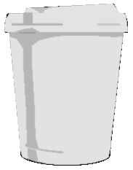

STARBUCKS
NEW YORK AN OFFICE CLERK
70%
Twelve kinds of media were represented at the show last month. It included the work offabic artists, glass artists, leather workers and also furniture and basket makers. The admission pro cess for artist is competitive. I’m always extremely
represented at the show last month. It included the work offabic

Slide 6

02 CONTENT
Twelve kinds of media
were represented at the show
last month. It included the work
offabic artists Twelve kinds
Twelve kinds of media

Slide 7


STARBUCKS
PowerPoint Free Share Content
Twelve kinds of media were represented at the show last month. It included the work offabic artists, glass artists, leather workers and also furniture and basket makers. The admission pro cess for artist is competitive. I’m always extremely
represented at the show last month. It included the work offabic

Slide 8

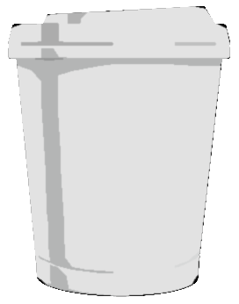

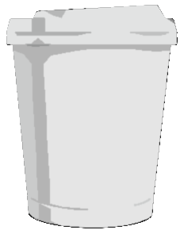


STARBUCKS
STARBUCKS COFFEE CONSUMPTION
70%
Twelve kinds of media were represented at the show last month. It included the work offabic artists, glass artists, leather workers and also furniture and basket makers. The admission pro cess for artist is
70%
5,000,000
2,000,000
3,000,000
70%
2014
2015
2016

Slide 9

03 CONTENT
Twelve kinds of media
were represented at the show
last month. It included the work
offabic artists Twelve kinds
Twelve kinds of media

Slide 10

STARBUCKS
USD 8,200,000
USD 5,780,000
USD 4,000,000
JAN
FEB
MAR
APR
MAY
JUN
JUL
AUG
SEP
OCT
NOV
DEC
PowerPoint Free Share Content
Twelve kinds of media were represented at the show last month. It included the work offabic artists, glass artists, leather workers and also furniture and basket makers. The admission pro cess for artist is competitive. I’m always extremely
represented at the show last month. It included the work offabic

Slide 11

STARBUCKS
ONE TOP
USER 4,000,000
PowerPoint Free Share Content
Twelve kinds of media were represented at the show last month. It included the work offabic artists, glass artists, leather workers and also furniture and basket makers. The admission pro cess for artist is competitive. I’m always extremely
represented at the show last month. It included the work offabic

Slide 12
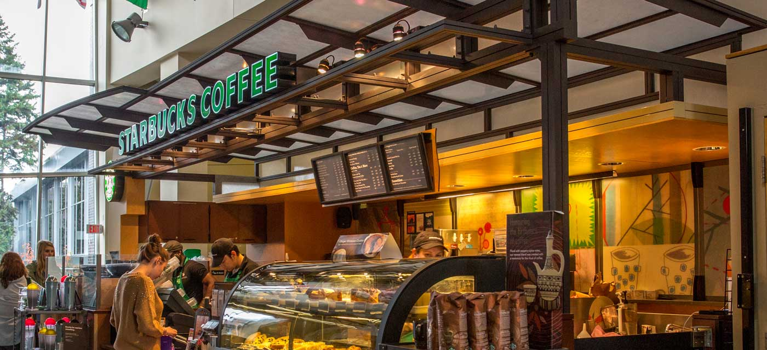

PowerPoint Free Share Content
POWERPOINT FREE SHARE BLOG : MADE IN YANG (NAVER)

